Slide 1

Alternative Fuels for Air Transport
Professor Jeff Jupp FREng FRAeS
Chairman - RAeS Greener By Design
Bristol University – 11th November 2014

Slide 2
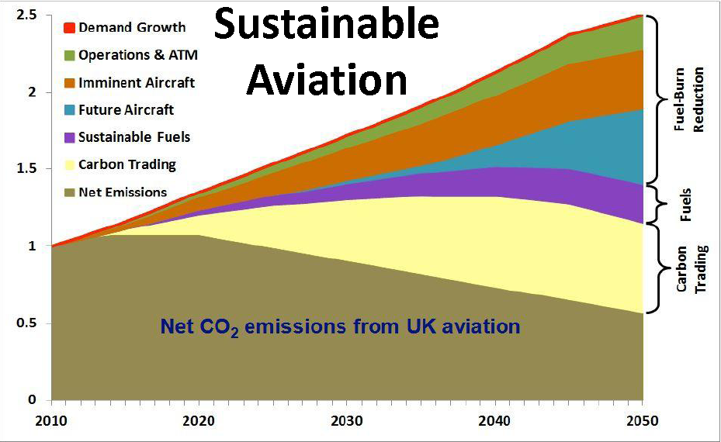

Slide 3
Requirements for an Aviation Fuel
High energy content (per unit weight and volume) - to minimise fuel burn, operating costs and CO₂ emissions
Low freeze point - to ensure fuel does not freeze at altitude
Excellent thermal stability – to provide required heat sink capability
Suitable flash point – to ensure the fuel will ignite (or not) in air as required
Good storage stability – to ensure quality of the fuel is maintained with time
Compatibility with materials in the fuel system
Equals a “Drop in” Kerosene replacement

Slide 4
Alternative Fuels for Aviation
 | Mass | Volume
 | MJ/kg | MJ/litre
Kerosene | 43.2 | 34.9
Liquid Hydrogen | 120 | 8.4
Methane | 50 | 21.2
Ethanol/Methanol* | 27.2/19.9
* Hygroscopic
A “Drop-in” synthetic Kerosene can be produced from biomass by the Fischer-Tropsch process or by hydrogenation of vegetable oils.

Slide 5
Aviation Biofuel Sustainable Feedstocks under active consideration:-
Camelina - Ready now
Jatropha - Ready in 2-4 years
Halophytes (eg Salicornia) - Ready in 2-4 years
Algae - Ready in 8-10 years
Several R&T consortia established; output has now reached “large scale demonstration quantities” (of order 250,000 gallons)

Slide 6
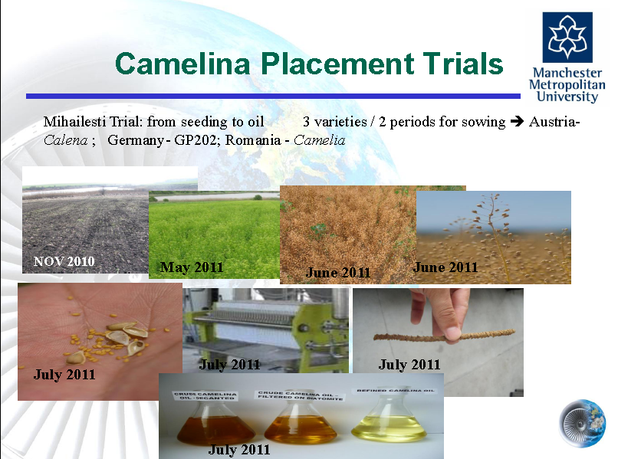

Slide 7
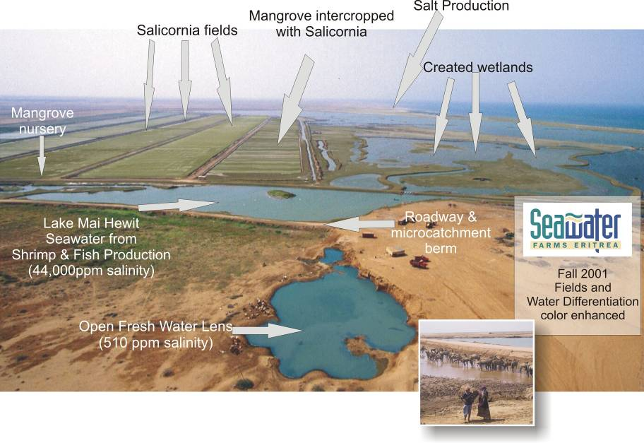
Notes:
7

Slide 9
Certification of “drop-in” biofuel
kerosene replacements
(Energy content, freeze point, thermal stability etc.)
Many flights have taken place over the last 3 years, typically one engine fed with a blend of kerosene and biofuel. All have been very successful.
Properties have been shown to be at least as good as fossil fuel kerosene (although additives for lubrication etc may be required above 50-50)
A 50/50 blend has already been certificated.
Worldwide Certification standards are being agreed.

Slide 10
Suggested time line for Bio-fuel Introduction
Certification for commercial use 2011
10 plus pilot plants in production 2013-15
1% of total fuel used is Biofuel 2015-20
20% Biofuel 2030- 50
100% Biofuel 2050 + ?

Slide 11
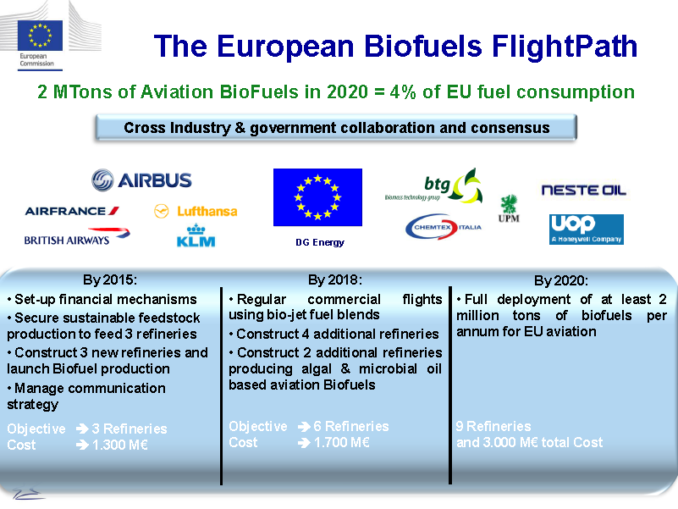

Slide 12
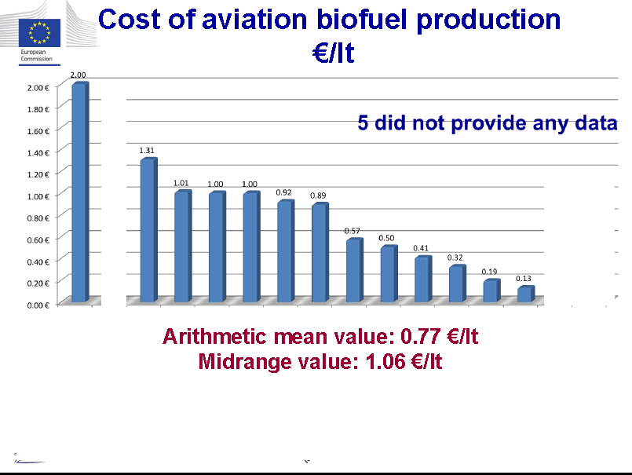

Slide 13
Biofuels Viable?

Slide 14
Other Fuel Possibilities
Other feed stocks
Use of waste cooking oil etc.
Wood waste
Direct production of hydrocarbons without photo synthesis in plants eg focused solar power. eg 2CO₂ + 3H₂O (+ Energy) = C₂H₆O +3O₂
Other Propulsion systems
Cryogenic Liquid Hydrogen
Electric Propulsion
Nuclear Fission
Nuclear Fusion

Slide 15
“Breaking News!”
Southwest Airlines has entered into an agreement with Colorado-based Red Rock Biofuels (RRB) to purchase around three million gallons per year of renewable jet biofuel.
First deliveries are due to start in 2016 and RRB says it will be able to provide its product at cost parity with conventional jet fuel.
RRB has just secured a $70 million federal grant to help fund the building of a $200 million refinery that will produce jet fuel, diesel and naphtha from forestry residues sourced from timber operations. Around 140,000 dry tons of woody biomass feedstock will be converted into at least 12 million gallons annually of the three products.

Slide 16
Should bio-fuels go to Aviation or Ground Transport?
Ground Transport:-
Easier certification requirements
Cheaper to produce
But other possibilities – Fuel Cells etc.
Aviation:-
There is no other alternative to a “drop-in” synthetic kerosene in the medium term (possibly liquid hydrogen very long term).
Stringent certification requirements.
Straight forward distribution logistics.
Motivated Industry due to current “environmental pressures”.

Slide 17
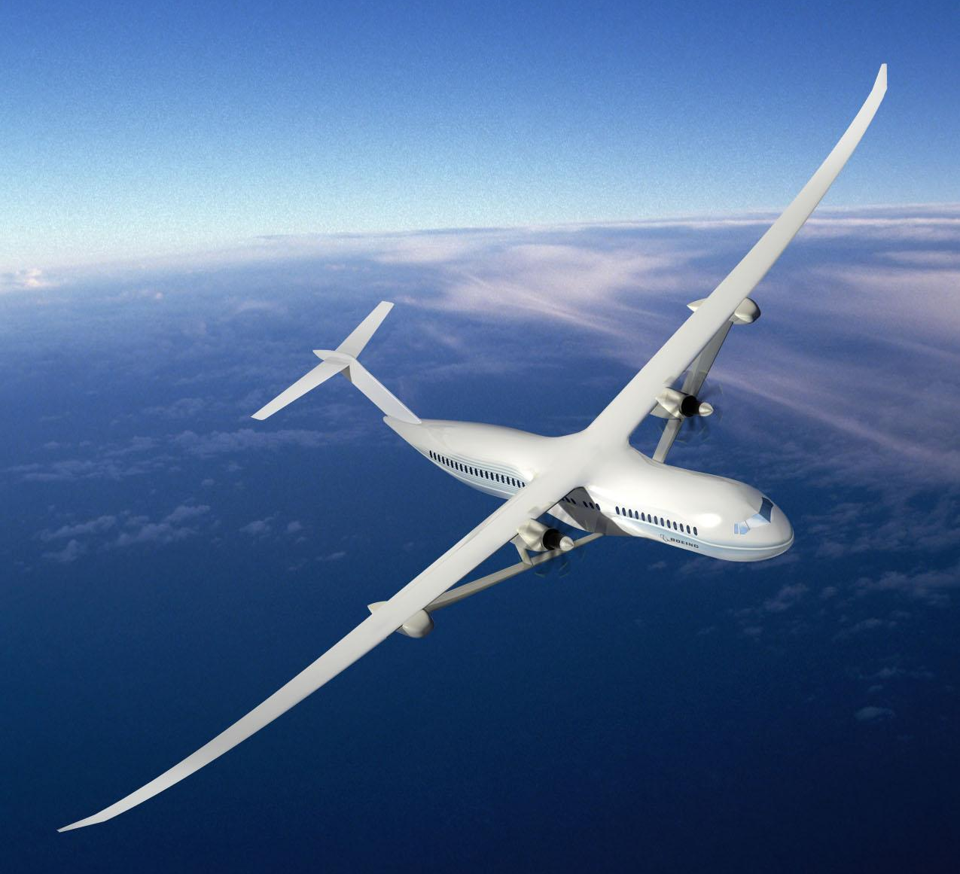
Electric Propulsion?
Boeing “SUGAR” Concept

Slide 18
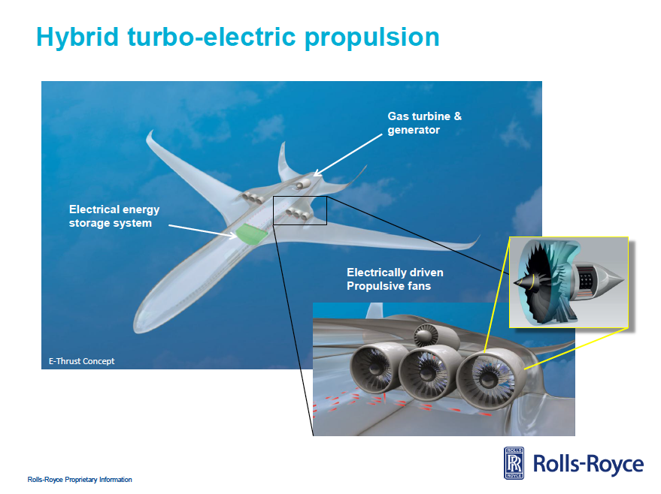

Slide 19
Skunk Works Reveals
Compact Fusion Reactor Details
Lockheed Martin aims to develop compact reactor prototype in five years, production unit in 10
The device is conceptually safer, cleaner and more powerful than much larger, current nuclear systems that rely on fission.
Lockheed believes its scalable concept will also be small and practical enough for applications ranging from interplanetary spacecraft and commercial ships to city power stations.
It may even revive the concept of large, nuclear-powered aircraft that virtually never require refueling—ideas of which were largely abandoned more than 50 years ago because of the dangers and complexities involved with nuclear fission reactors.
Aviation Week, 20th October 2014

Slide 21
